Slide 1
Requirements Engineering:
Specification & Validation
Software Requirements and Design
CITS4401
Lecture 7 part 2
Notes:
Revised Mar 2022 RCO
Earlier Versions: RCO, DH, GMH

Slide 2
Key ideas (this week)
Testing requirements
  Convince me!
Prototyping requirements
  Show me!
Requirements Specification Document
  Tell me!
Managing requirements
Maintain me!

Slide 3
Why do you think requirements change so much?
After all, don't people know what they want?
It is difficult to predict in advance which software requirements will persist and which will change.
It is equally difficult to predict how customer priorities will change as the project proceeds.
It is often difficult for people to verbalize their software needs until they see a working prototype and realize that they had forgotten to consider something important.

Slide 4
Why Prototype?
Prototyping is commonly a means for validating the software engineer’s interpretation of the software requirements, as well as for eliciting new requirements.
The advantage of prototypes is that they can make it easier to interpret the software engineer’s assumptions and, where needed, give useful feedback on why they are wrong.
For example, the dynamic behaviour of a user interface can be better understood through an animated prototype than through textual description or graphical models.
Source: SWEBoK Guide 6.2 Prototyping

Slide 5
Prototyping
Prototypes for requirements validation demonstrate the requirements and help stakeholders discover problems
Analysis prototypes can be lightweight and need not contain SW at all; they are for discovering what the users want
Validation prototypes should be complete, reasonably efficient and robust. It should be possible to use them in the same way as the required system
User documentation and training should be provided

Slide 6
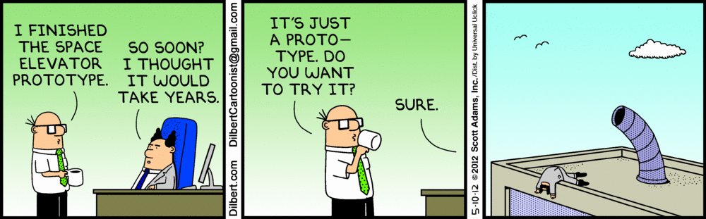
Dilbert prototyping

Slide 7
Types of Prototype
Software: create a new executable prototype
  Use rapid prototyping tools (eg UI as html forms)
Write a first draft of the user interface
  Incremental development
Modify existing SW to create a prototype for the new system
Generate screen mock-ups with drawing software (eg powerpoint is fine)
Draw mock-ups on white-boards or paper

Slide 8
Provide three examples of software that are amenable to the prototyping model.
Be specific.
Software applications that are relatively easy to prototype almost always involve human-machine interaction and/or heavy computer graphics.
Other applications that are sometimes amenable to prototyping are certain classes of mathematical algorithms, subset of command driven systems and other applications where results can be easily examined without real-time interaction.
Applications that are difficult to prototype include control and process control functions, many classes of real-time applications and embedded software.
Source Pressman 2.6

Slide 9
User manual development
Writing a user manual from the requirements forces a detailed requirements analysis and thus can reveal problems with the document
Information in the user manual
  Description of the functionality and how it is implemented
  Which parts of the system have not been implemented
  How to get out of trouble
  How to install and get started with the system

Slide 10
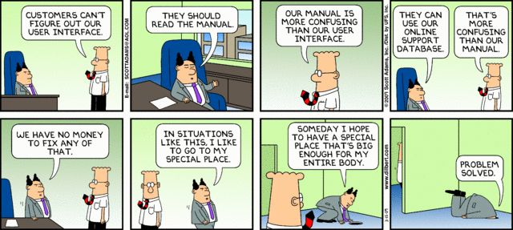
Dilbert user manual

Slide 11
Summary
Prototyping is effective for requirements validation if it is in the initial stages of software engineering.
Prototypes can be physical (eg on paper) or written as software
Writing a user manual early can help to clarify requirements

